Slide 1
Large Deflection (Plate)

Slide 2
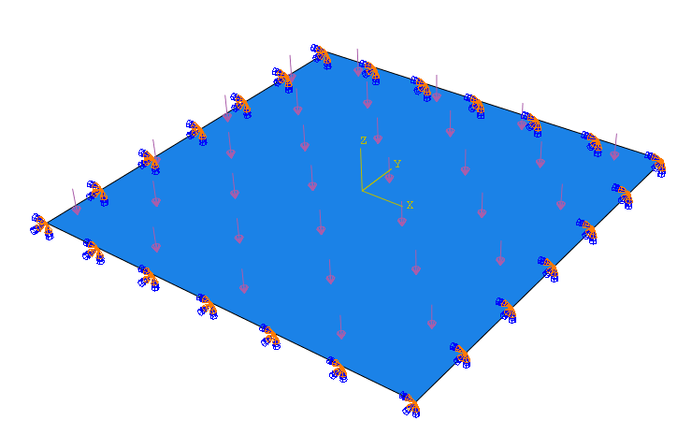
Model Set Up
2 Distributed Loads Applied:
P1 = 10000 N
P2 = 15000 N
2a = 1 m
2a = 1 m
Material Data:
E = 6.87e10 Pa
v = 0.30
Thickness = 5mm
Clamped on all edges

Slide 3
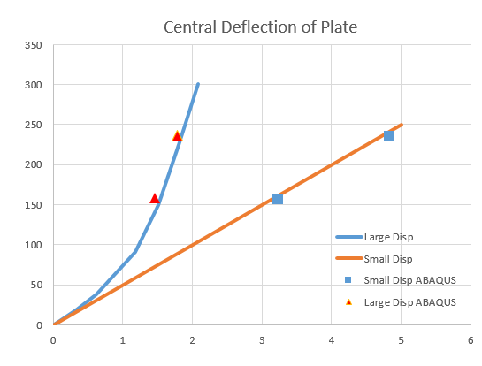
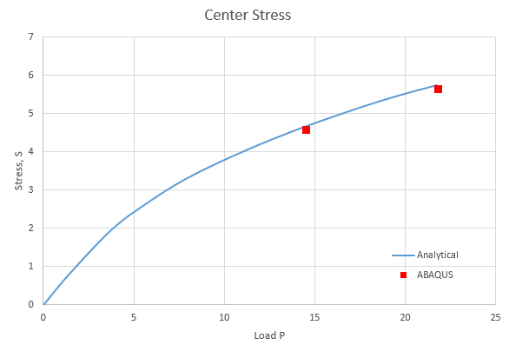



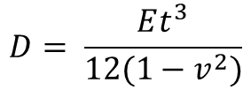

Results
(Large Disp.)
$$\frac{PDt}{a^{2}}$$
S $=\frac{σa^{2}}{Et^{2}}$
2
1
2
1
1
2
(Book)
(Book)
$$\frac{w}{t}$$
P $=\frac{qa^{4}}{Eh^{4}}$
P = 10,000 N
P = 15,000 N
$$D= \frac{Et^{3}}{12(1−v^{2})}$$

Slide 4
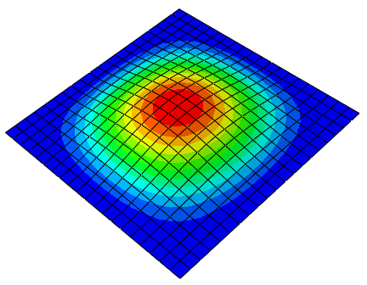
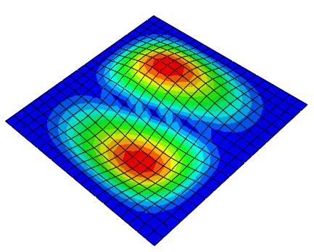
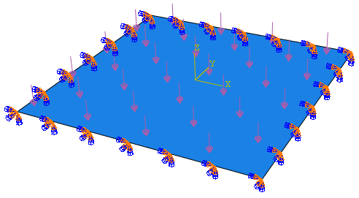
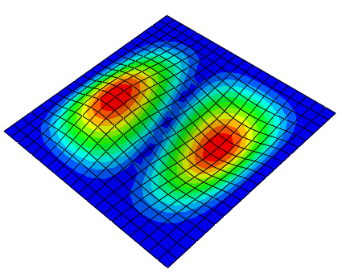
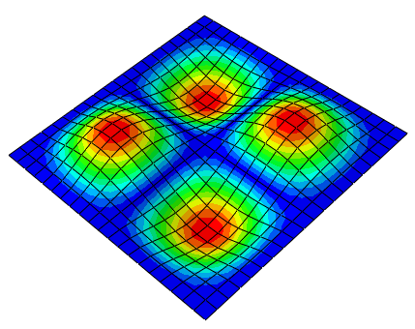
Results Frequency
Distributed load applied to simulate preload:
P = 10000 N
Mode 1
Mode 2
Mode 3
Mode 4
 | Free Response | Preloaded Response w/o Large Disp. | Preloaded Response w/t Large Disp.
1 | 43.8 | 43.8 | 88.6
2 | 90.3 | 90.3 | 123.1
3 | 132.9 | 132.9 | 159.7
4 | 165.0 | 165.0 | 192.6

